Slide 1
How can we ensure the model is fair?

Slide 2
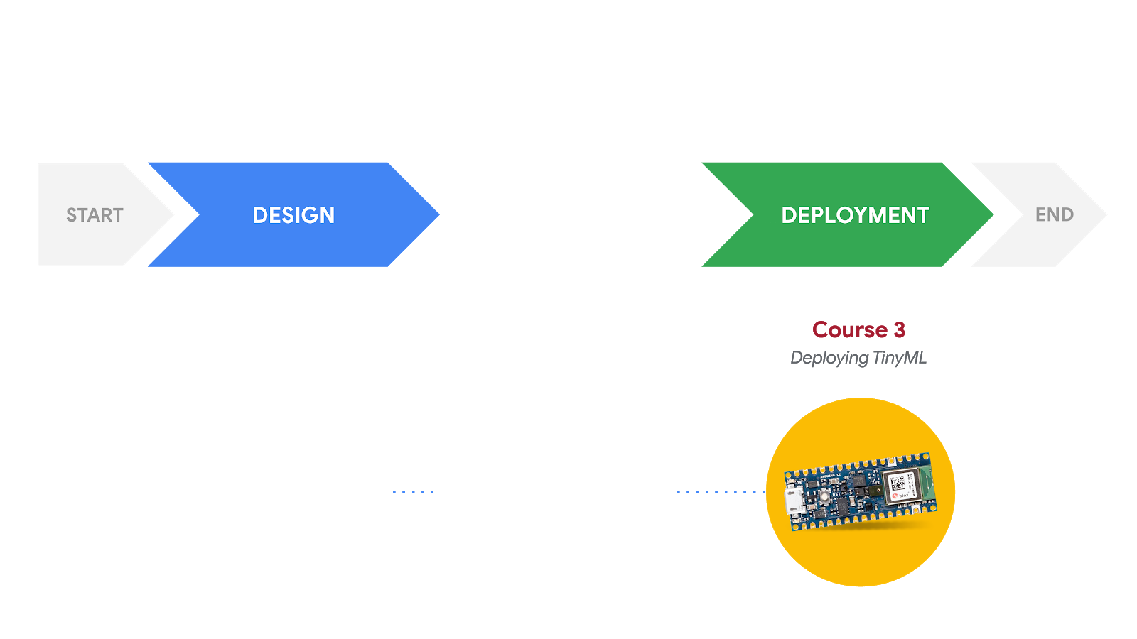
Responsible AI: Human-Centered Design
DEVELOPMENT
Course 1
Fundamentals of TinyML
Course 2
Applications of TinyML
What am I building?
Who am I building this for?
What are the consequences for the user if it fails?
What data will be collected to train the model?
Is the dataset biased?
How can we ensure the model is fair?

Slide 3

Unfairness in ML
Model exhibits discriminatory biases, perpetuates inequality or performs less well for historically disadvantaged groups
All ML discriminates (it just means to recognize a distinction, differentiate)
Fairness is concerned with wrongful discrimination
Notes:
https://thenounproject.com/search/?q=fairness&i=3152286
Over the past few years, fairness has emerged as a matter of serious concern within machine learning. There is growing recognition that even models developed with the best of intentions may exhibit discriminatory biases, perpetuate inequality, or perform less well for historically disadvantaged groups.

Slide 4
Age
Sex
Protected
Classes
Disability
Race
Medical History
Religion
Marital Status
National Origin
Notes:
Protected classes include: racial, ethnic, religious, and national minorities; women; seniors; and people with genetic vulnerabilities, disabilities, or pre-existing medical conditions
Applicants, employees and former employees are protected from employment discrimination based on race, color, religion, sex (including pregnancy, sexual orientation, or gender identity), national origin, age (40 or older), disability and genetic information (including family medical history).
Race – Civil Rights Act of 1964
Religion – Civil Rights Act of 1964
National origin – Civil Rights Act of 1964
Age (40 and over) – Age Discrimination in Employment Act of 1967
Sex – Equal Pay Act of 1963 and Civil Rights Act of 1964
Sexual orientation and gender identity as of Bostock v. Clayton County – Civil Rights Act of 1964^{[2]}
Pregnancy – Pregnancy Discrimination Act
Familial status – Civil Rights Act of 1968 Title VIII: Prohibits discrimination for having children, with an exception for senior housing. Also prohibits making a preference for those with children.
Disability status – Rehabilitation Act of 1973 and Americans with Disabilities Act of 1990
Veteran status – Vietnam Era Veterans' Readjustment Assistance Act of 1974 and Uniformed Services Employment and Reemployment Rights Act
Genetic information – Genetic Information Nondiscrimination Act

Slide 5
Discrimination
Disparate Treatment:
Membership in a protected class is used as an input to the model, decisions are differentiated on that basis in a way that disadvantages members of a protected class
Disparate Impact:
Outcomes of the model disproportionately disadvantage members of a protected class

Slide 6

1. Group Unawareness
Sensitive attributes are not included as features of the data (e.g. race, gender)
Pro: Avoids disparate treatment
Con: Possibility of highly correlated
features that are proxies of the
sensitive attribute
Notes:
https://thenounproject.com/search/?q=blindfold&i=2884566

Slide 7
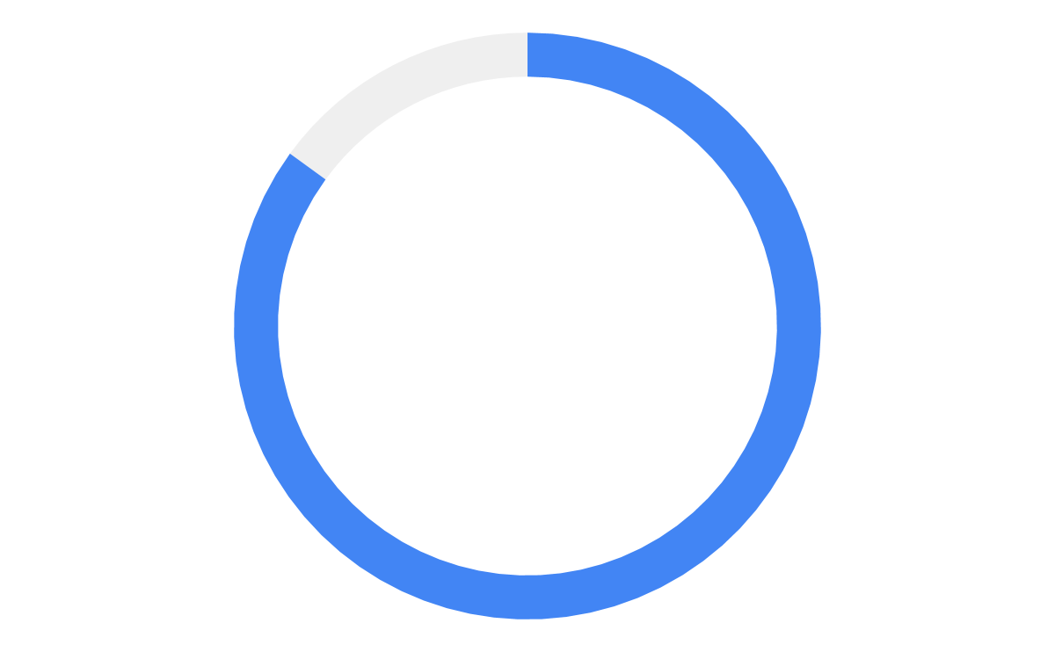
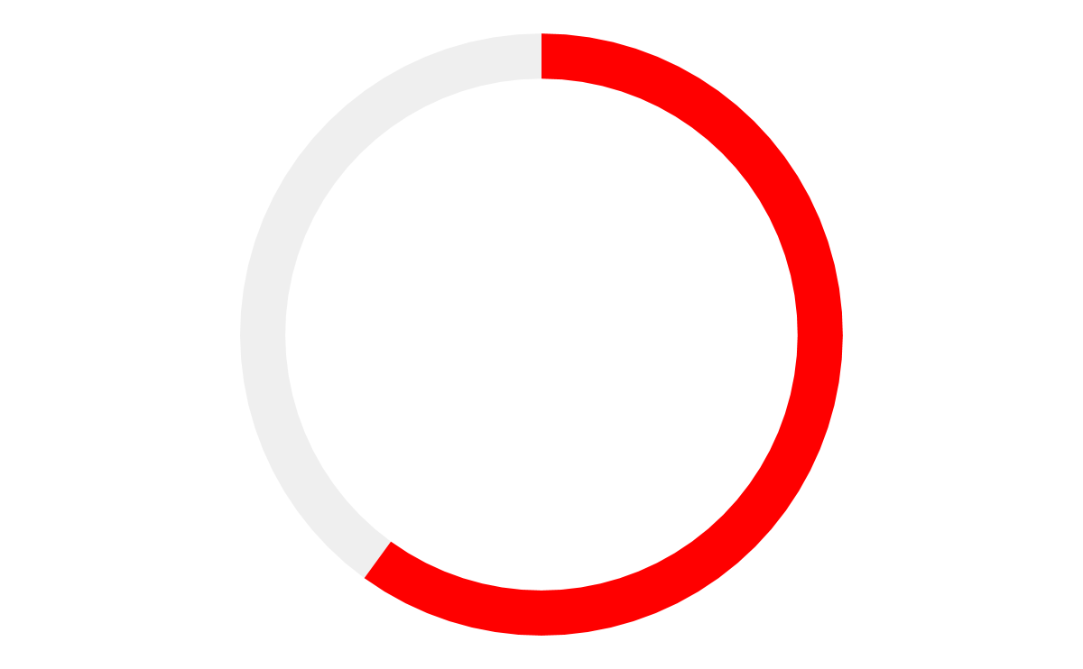
2. Group Threshold
Counteract historical biases in data by adjusting confidence thresholds independently for each group
85%
60%
Group A
Group B
Notes:
Counteract historical biases by adjusting confidence thresholds independently
Image classifier?
Expert #2 strongly disagrees with #1. Because of historical biases reflected in the data used to create the system's model, women can look less loan-worthy than men. For example, women's work histories are more likely to be interrupted by multi-month gaps – maternity leave, for example – and that might count against them in the machine learning system's model. So, we should be able to adjust the confidence thresholds for men and women independently. If that means we have to tell the machine that to put a man's application into the Approved pile requires a 0.6 confidence level that he will pay back a loan, but only a 0.3 confidence level that a woman will, so be it.

Slide 8
3. Demographic Parity
 | Actually Healthy = Yes | Actually Healthy = No
Predicted Healthy = Yes | True Positive | False Positive
Predicted Healthy = No | False Negative | True Negative
The positive rate is the same across groups

Slide 9
Problem with Demographic Parity
Introduced False Negatives!
True positive
False positive
True negative
False negative
Group A
PR is 6/12
50%
Group B
PR is 4/8
50%

Slide 10
4. Equal Opportunity
 | Actually Healthy = Yes | Actually Healthy = No
Predicted Healthy = Yes | True Positive | False Positive
Predicted Healthy = No | False Negative | True Negative
Qualified individuals should have an equal chance of being correctly classified for a desirable outcome.

Slide 11
Problem with Equality of Opportunity
Introduced False Positives!
True positive
False positive
True negative
False negative
Group A
TPR is 9/12
75%
Group B
TPR is 3/4
75%
Notes:
TPR - TP/ TP + FN

Slide 12
4. Equal Accuracy
 | Actually Disease = Yes | Actually Disease = No
Predicted Disease = Yes | True Positive | False Positive
Predicted Disease = No | False Negative | True Negative
The percentage of correct classifications should be the same for all individuals

Slide 13
Problem with Equal Accuracy
Higher rate of false negatives
Higher rate of false positives
True positive
False positive
True negative
False negative
Group A
Accuracy is 75%
Group B
Accuracy is 75%

Slide 14

Impossibility Theorem
We cannot satisfy all fairness metrics
at the same time!
For example:
Group Unawareness is incompatible with Group Threshold
Equal Opportunity is incompatible with Equal Accuracy
Notes:
Hazard: reused from 1-3-7

Slide 15
How can we mitigate unfairness in ML?
Notes:
Acknowledge how this area of ML research is still developing, but we’ll highlight some things you can do. First we’ll start by going over common traps/pitfalls that lead to fairness problems and how to avoid them, then talk about industry solutions/resources.

Slide 16
The Framing Trap
03
The Algorithmic Frame
Do properties of the output match the input? Does the algorithm provide good accuracy on unseen data?
01
02
Notes:
Repurposing algorithmic solutions
Fairness is not tied to specific objects but to specific social contexts
Fair outcomes will be disrupted as soon as code, device or software moves to a different context
Failure to understand how repurposing algorithmic solutions designed for one social context may be misleading, inaccurate, or otherwise do harm when applied to a different context

Slide 17
The Framing Trap
3
The Algorithmic Frame
Do properties of the output match the input? Does the algorithm provide good accuracy on unseen data?
1
2
The Data Frame
Has bias been removed from the training data? Does the demographic information of the data require optimization of the model?
Notes:
Repurposing algorithmic solutions
Fairness is not tied to specific objects but to specific social contexts
Fair outcomes will be disrupted as soon as code, device or software moves to a different context
Failure to understand how repurposing algorithmic solutions designed for one social context may be misleading, inaccurate, or otherwise do harm when applied to a different context

Slide 18
The Framing Trap
The Sociotechnical Frame
How does the model operate when considered as part of a system of humans and social institutions?
03
The Algorithmic Frame
Do properties of the output match the input? Does the algorithm provide good accuracy on unseen data?
01
02
The Data Frame
Has bias been removed from the training data? Does the demographic information of the data require optimization of the model?
Notes:
Repurposing algorithmic solutions
Fairness is not tied to specific objects but to specific social contexts
Fair outcomes will be disrupted as soon as code, device or software moves to a different context
Failure to understand how repurposing algorithmic solutions designed for one social context may be misleading, inaccurate, or otherwise do harm when applied to a different context

Slide 19
The Framing Trap
Algorithmic Frame
Data Frame
Sociotechnical Frame
Do properties of the output match the input? Does the algorithm provide good accuracy on unseen data?
Has bias been removed from the training data? Does the demographic information of the data require optimization of the model?
How does the model operate when considered as part of a system of humans and social institutions?
Notes:
Repurposing algorithmic solutions
Fairness is not tied to specific objects but to specific social contexts
Fair outcomes will be disrupted as soon as code, device or software moves to a different context
Failure to understand how repurposing algorithmic solutions designed for one social context may be misleading, inaccurate, or otherwise do harm when applied to a different context

Slide 20
The Framing Trap
Algorithmic Frame
Data Frame
Sociotechnical Frame
Do properties of the output match the input? Does the algorithm provide good accuracy on unseen data?
Has bias been removed from the training data? Does the demographic information of the data require optimization of the model?
How does the model operate when considered as part of a system of humans and social institutions?
Notes:
Repurposing algorithmic solutions
Fairness is not tied to specific objects but to specific social contexts
Fair outcomes will be disrupted as soon as code, device or software moves to a different context
Failure to understand how repurposing algorithmic solutions designed for one social context may be misleading, inaccurate, or otherwise do harm when applied to a different context

Slide 21
The Framing Trap
Algorithmic Frame
Data Frame
Sociotechnical Frame
Do properties of the output match the input? Does the algorithm provide good accuracy on unseen data?
Has bias been removed from the training data? Does the demographic information of the data require optimization of the model?
How does the model operate when considered as part of a system of humans and social institutions?
Notes:
Repurposing algorithmic solutions
Fairness is not tied to specific objects but to specific social contexts
Fair outcomes will be disrupted as soon as code, device or software moves to a different context
Failure to understand how repurposing algorithmic solutions designed for one social context may be misleading, inaccurate, or otherwise do harm when applied to a different context

Slide 22

The Portability Trap
California, US
Nigeria, Africa
Notes:
https://thenounproject.com/search/?q=world+map&i=3090683

Slide 23
The Portability Trap
Context Matters!
Repurposing algorithmic solutions may not preserve fair outcomes.
California, US
Nigeria, Africa

Slide 24


The Formalism Trap
Which mathematical definition of fairness should I choose?
Notes:
https://commons.wikimedia.org/wiki/File:Noto_Emoji_Oreo_1f914.svg
https://thenounproject.com/search/?q=thought+bubble&i=788841

Slide 25
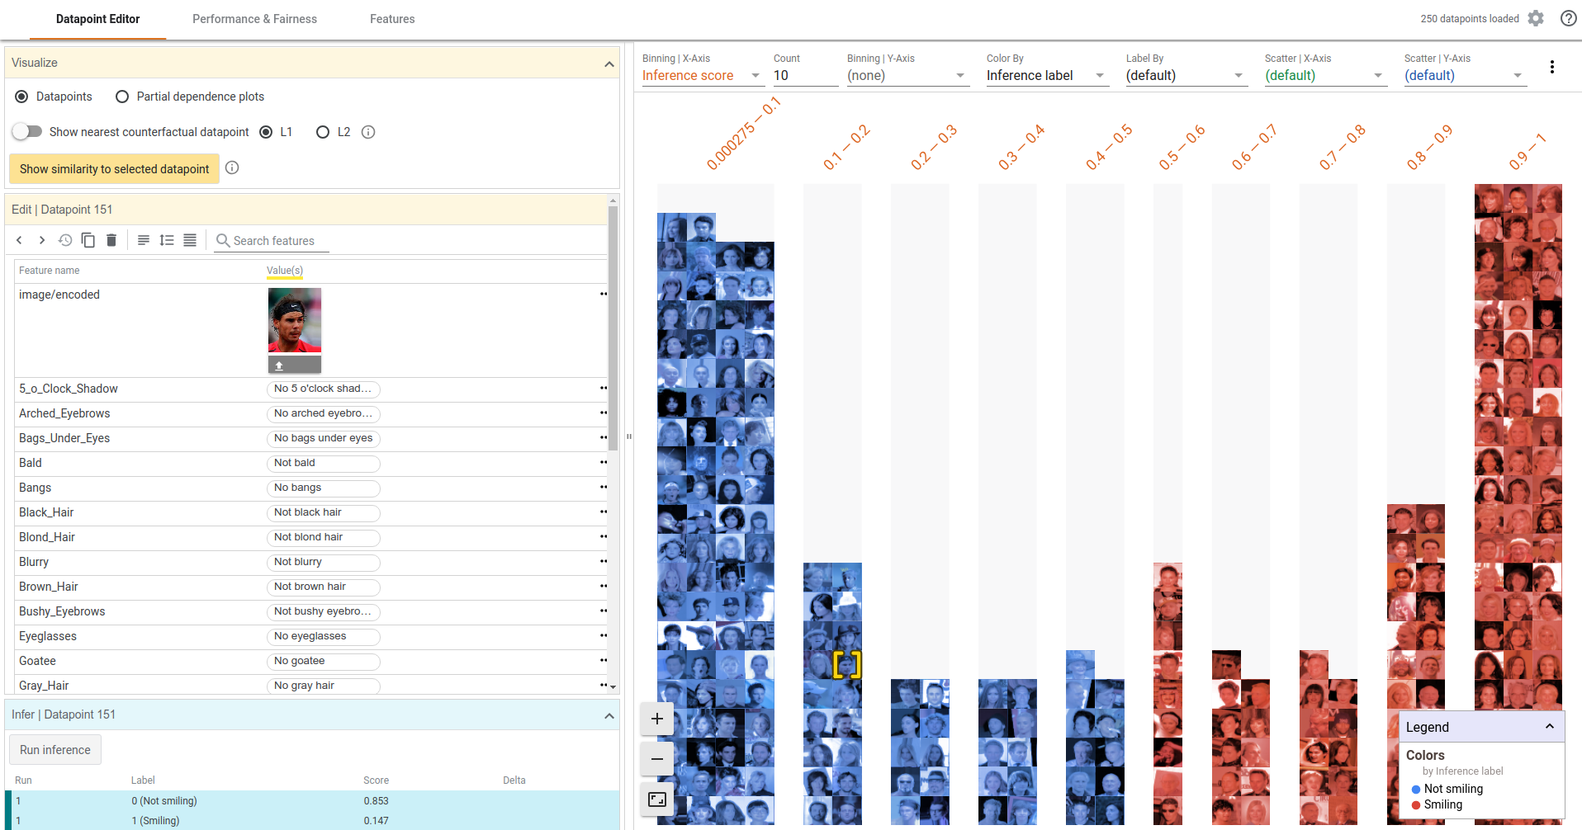
Google’s What-If Tool
Notes:
https://github.com/PAIR-code/what-if-tool
Apache License

